Slide 1

Understanding Cache lookup property of table

Slide 2
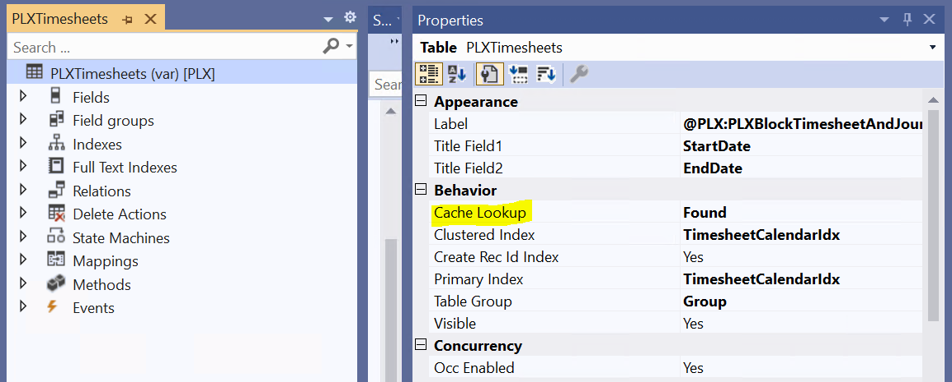
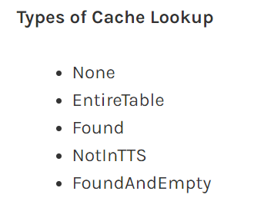

Cache settings for a table can be found in the following location in the application: AOT > Data Dictionary > Tables > [TableName] > Properties > CacheLookup

Slide 3
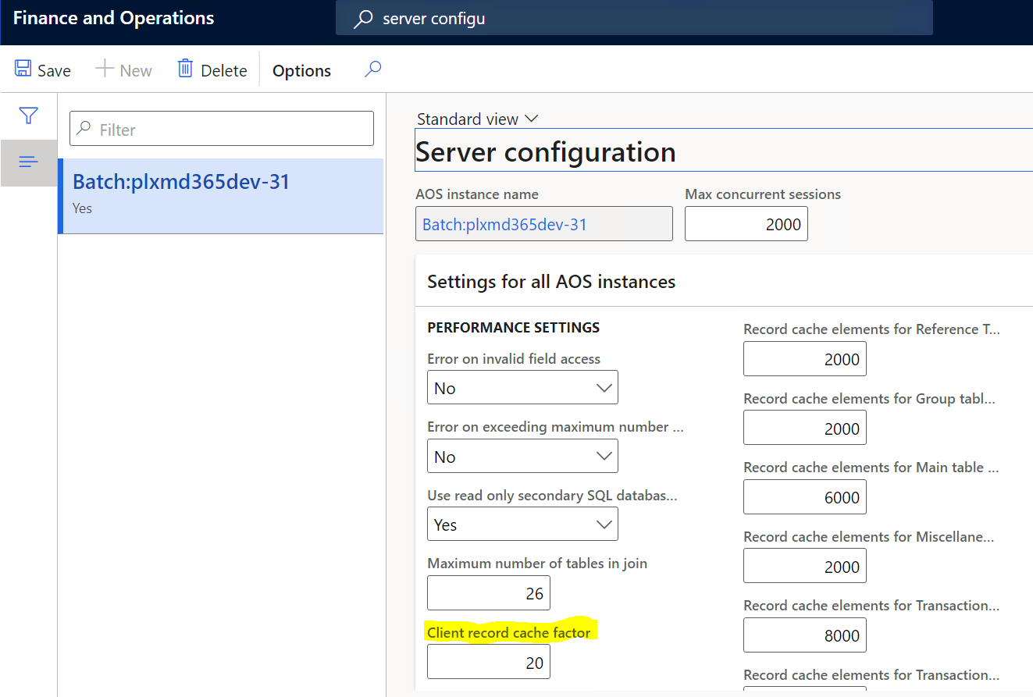
Two types of caching:
Client Cache
Server Cache

Slide 4
Two types of table caching:
Set based caching
At design time, by setting the table's CacheLookup property to EntireTable.
In code, by using the RecordViewCache class.
Single record caching
The CacheLookup property on the table is enabled by setting it to one of the following values: NotInTTS, Found, FoundAndEmpty.
The record buffer disableCache method has not been called with a parameter of true.

Slide 5
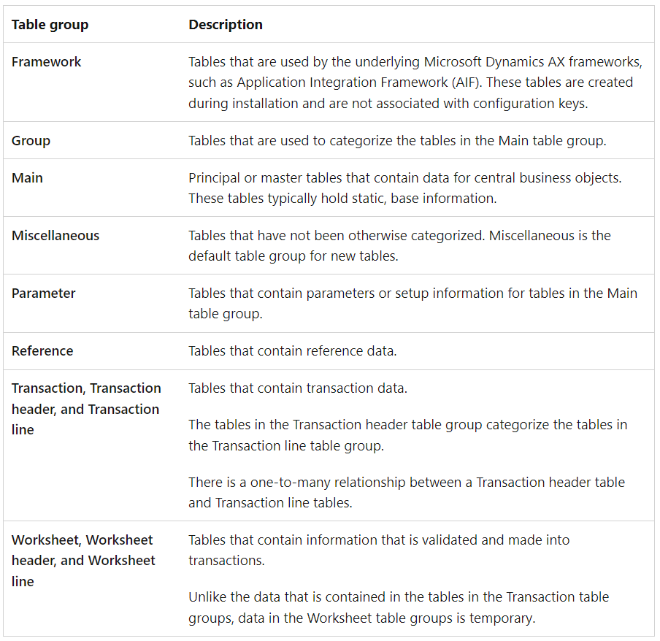
Best practices
Set the appropriate table group depending on how the table is used

Slide 6
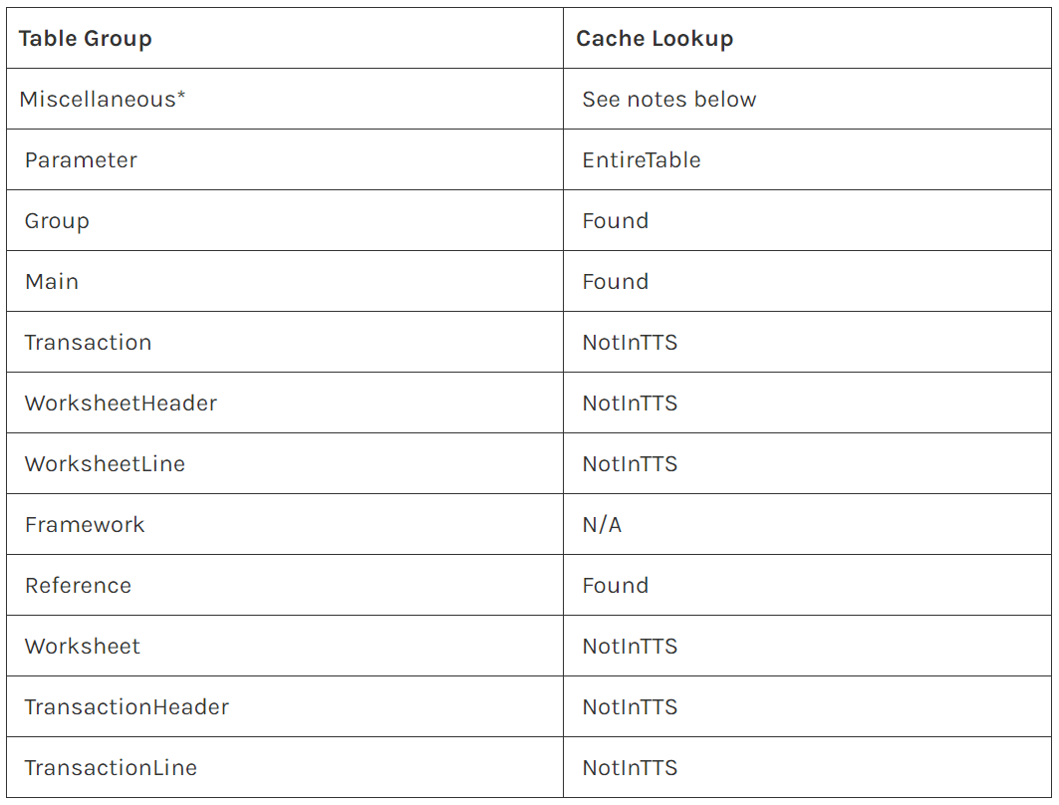
Best practices
Below is a list which shows to use the different type of cache lookup property as per table group

Slide 7

Contact Us
www.axaptamasters.com
+389 77 00 00 00
email@axaptamasters.com

